Slide 1
Lasso and Ridge Regression
The Nappers
Group 5
Islam, Shervorn, Shirley

Slide 2
What is it?
Lasso and Ridge are both Regression models but with a penalty (also called a regularization).
They add a penalty to how big your coefficients can get, each in a different way.
Lasso will shrink unimportant coefficients to zero and basically ‘drop’ features that don’t seem to have a high impact on the model
Ridge will shrink coefficients to prevent any of them from being too big or extreme
Regularization solves the problem of overfitting
Lasso regularization is also called L1 penalty
Ridge regularization is also called L2 penalty
Both have a hyperparameter that controls how much you want to penalize the coefficients

Slide 3
Lasso Regularization
Advantages
Disadvantages
Biased coefficients
Shrunken coefficients
Does not represent the true magnitude of the relationship between the features and the outcome
Struggle with correlated features
A feature gets selected somewhat arbitrarily
All other features that are highly correlated with that feature are dropped from the model
May lead to the false conclusion that only the feature that was selected to remain in the model is important
Automatic features selection
Decides which features are important
Sets the coefficients for features it does not consider interesting to zero
Reduces unwanted noise from useless features
Creates a simple model
Reduced overfitting
Penalty helps prevent the model from overfitting
Decreases model complexity

Slide 4
Ridge Regularization
Advantages
Disadvantages
Handles correlated features
Too many correlated features may lead to overfitting
Reduces multicollinearity
Reduced overfitting
Penalty shrinks some coefficients close to zero
Biased coefficients
Not capable of performing feature selection

Slide 5
Some Similarities and Differences Between Ridge and Lasso Regressions:
Ridge Regression | Lasso Regression
Shrinks the coefficients toward zero | Shrinks and encourages some coefficients to be exactly zero
Does not eliminate any features | Can eliminate some features
Suitable when all features are important | Suitable when some features are irrelevant or redundant
More computationally efficient | Less computationally efficient
Requires setting a hyperparameter | Requires setting a hyperparameter
Performs better when there are many small to medium-sized coefficients | Performs better when there are a few large coefficients

Slide 6
Unique LASSO Regression Hyperparameters
precompute : ‘auto’, bool or array-like of shape (n_features, n_features), default = ’auto’
Allows you to use a precomputed Gram matrix to speed up calculations; The Gram matrix can also be passed as argument.
warm_start : bool, default = False
When set to True, reuse the solution of the previous call to fit as initialization, otherwise, just erase the previous solution.
selection : {‘cyclic’, ‘random’}, default = ’cyclic’
If set to ‘random’, a random coefficient is updated every iteration rather than looping over features sequentially by default; this often leads to significantly faster convergence.

Slide 7
Unique Ridge Regression Hyperparameters
solver : {‘auto’, ‘svd’, ‘cholesky’, ‘lsqr’, ‘sparse_cg’, ‘sag’, ‘saga’, ‘lbfgs’}, default = ’auto’
Allows you to choose which solver to use during computational routines from the list above.
auto: chooses the solver automatically based on the type of data
svd: uses a Singular Value Decomposition of X to compute the Ridge coefficients
cholesky: uses the standard scipy.linalg.solve function to obtain a closed-form solution
lsqr: uses the dedicated regularized least-squares routine scipy.sparse.linalg.lsqr
Note: All solvers except ‘svd’ support both dense and sparse datasets where dense datasets are defined as datasets with filled with mostly non-zero values while sparse datasets are filled with zero values.

Slide 8
Unique Ridge Regression Hyperparameters Cont.
positive : bool, default = False
When set to True, forces the coefficients to be positive.
Note: The only solver that supports only positive coefficients is ‘lbfgs’.
fit_intercept : bool, default = True
Whether to fit the intercept for this model. If set to false, no intercept will be used in calculations (i.e. X and y are expected to be centered).
Note: Only ‘lsqr’, ‘sag’, ‘sparse_cg’, and ‘lbfgs’ support sparse input when fit_intercept is True.

Slide 9
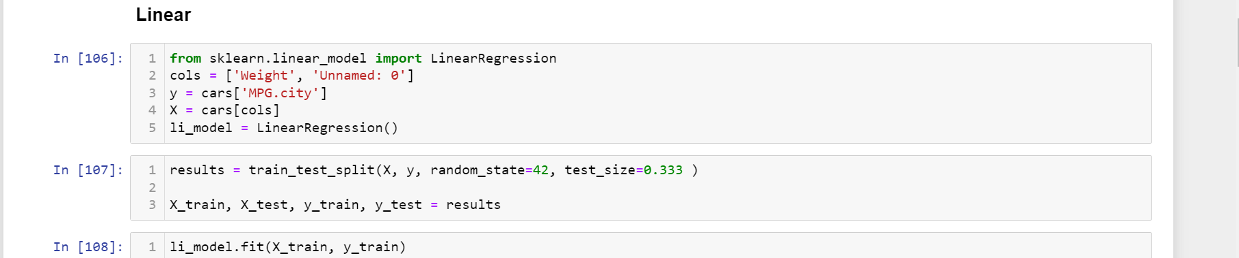
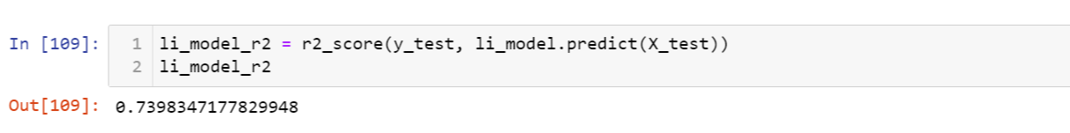
Cars93 Dataset

Slide 10
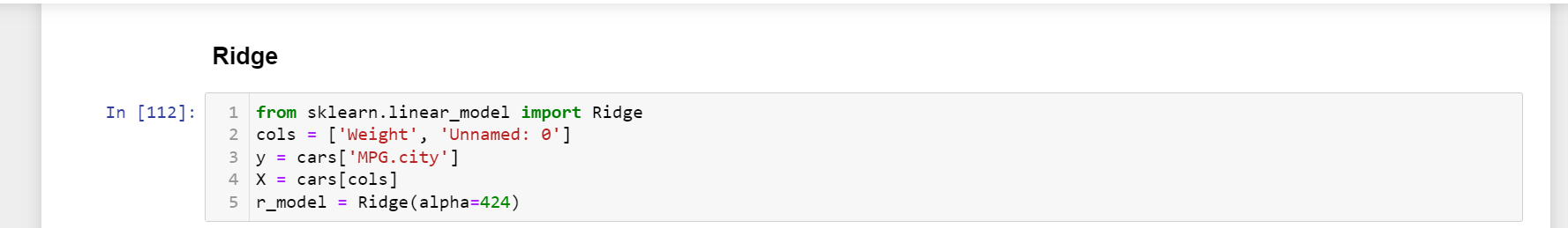
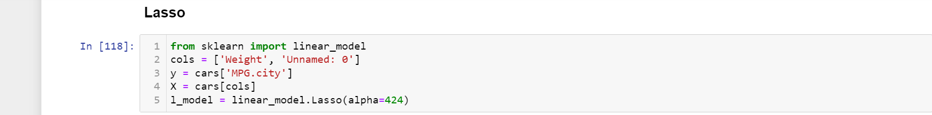

Slide 11
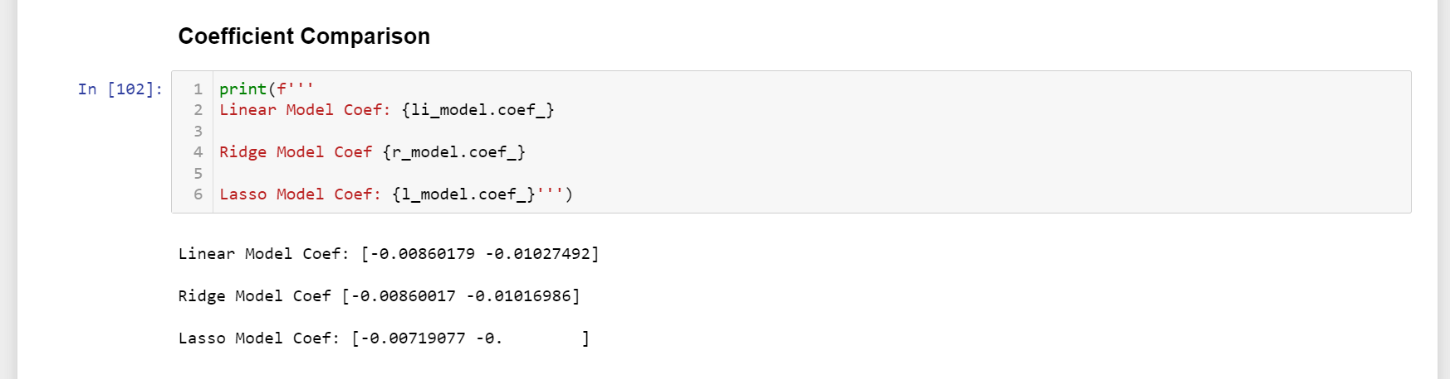

Slide 12
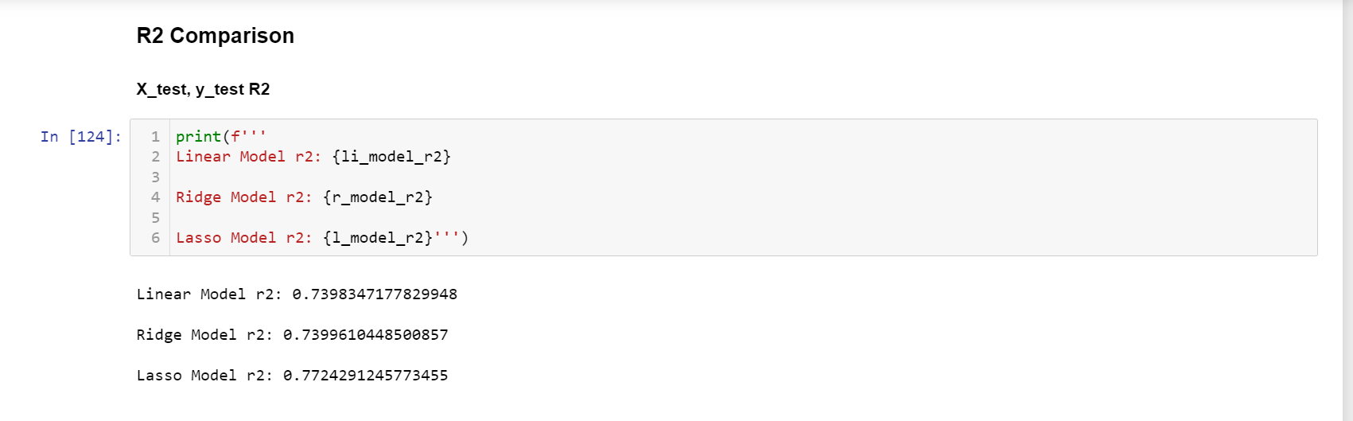
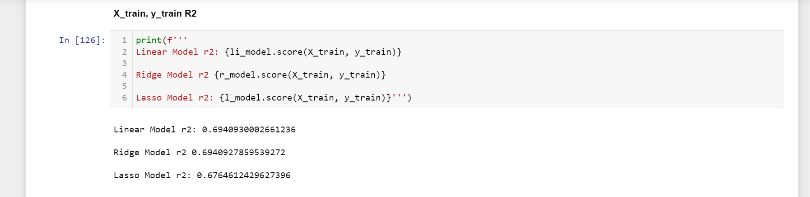

Slide 13
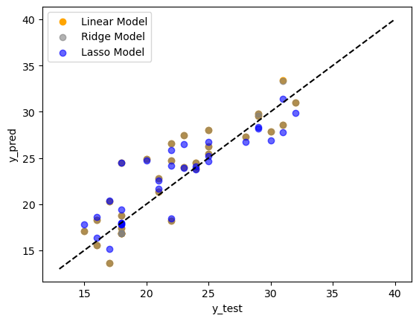

Slide 14
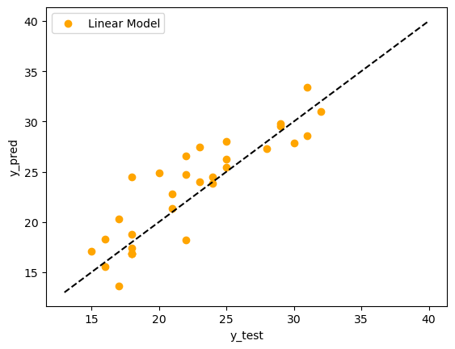
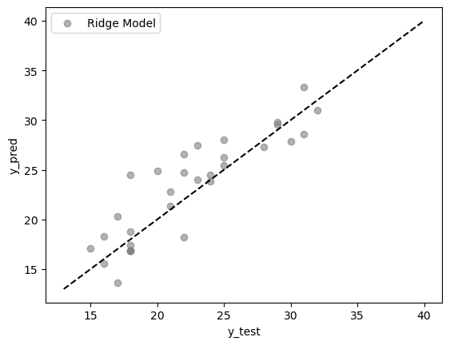
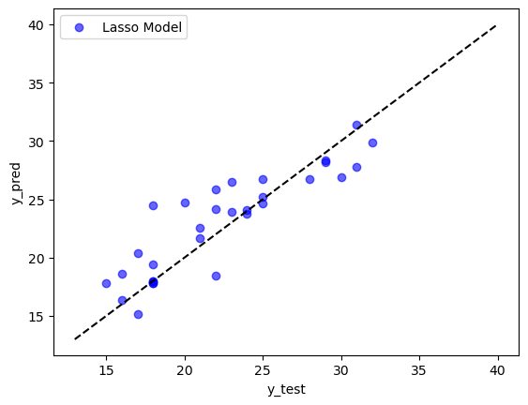
Linear = 5 data points Ridge = 5 data points Lasso = 8 data points

Slide 15
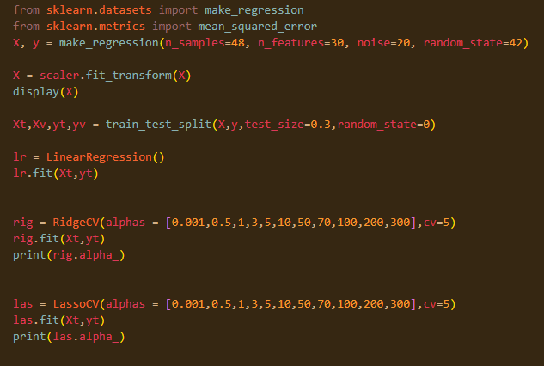
Make_regression() - Linear Regression Code
Make_regression - Generates a random regression problem
Noise - The standard deviation of the gaussian noise applied to the output. - Meaningless data to try to make model worse
N_samples - The number of samples.
N_features - The number of features.
RidgeCV and LassoCV are used in linear regression where you can pass in many alpha values and it will run the fit on all of them and give you back/ use the best one it found from the list.
Alpha hyperparameter in linear regression penalizes the weights/coefficients more when it’s larger and less when it’s smaller
Cv = cross validation strategy & pass in number of folds to use
Use 48 observations and 30 features with 20 noise

Slide 16
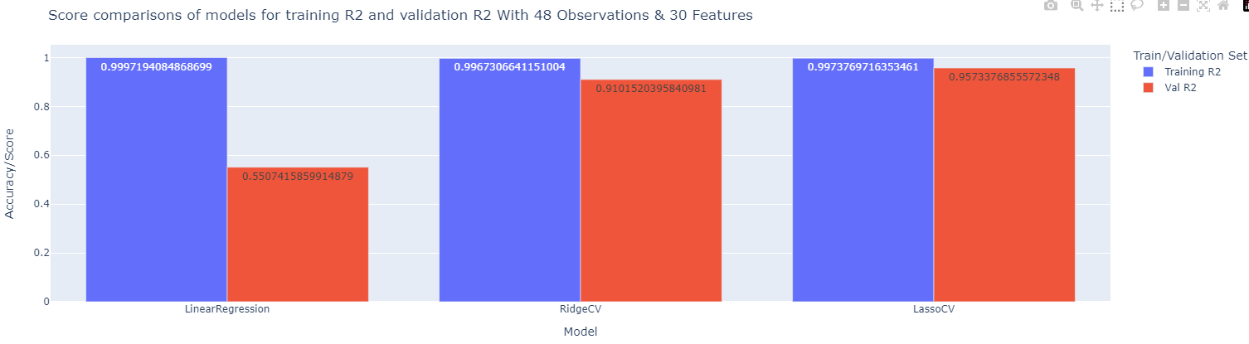
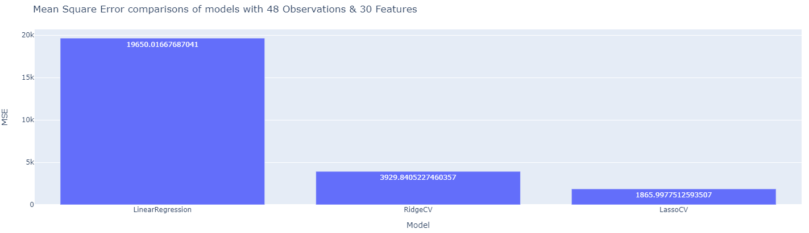
Make_regression() - Training and Validation Scores between models on 30 features, 48 observations
Ridge and Lasso did better on both training and validation
Linear Regression without regularization was clearly overfitted

Slide 17
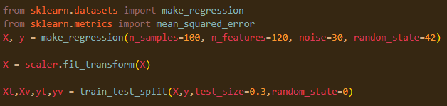
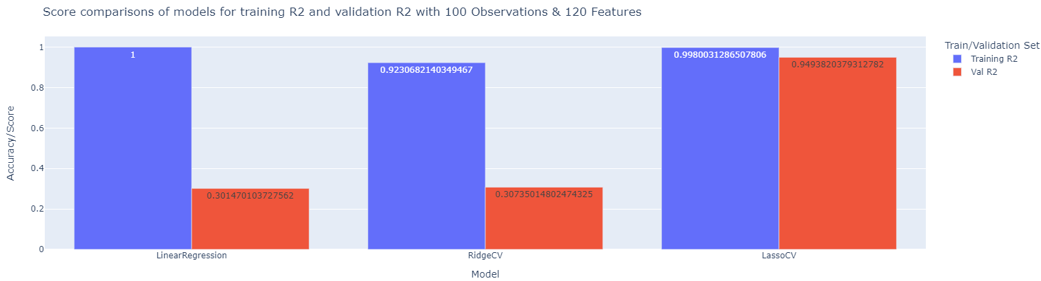
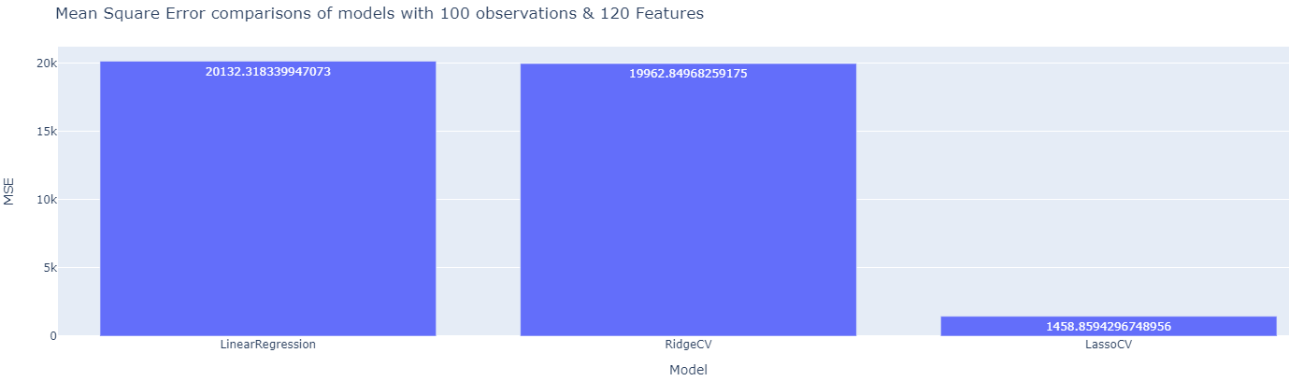
Make_regression() - Training and Validation between models on 120 features, 100 observations
Ridge does poorly this time because there are too many features
Lasso does better because it drops most of these features

Slide 18
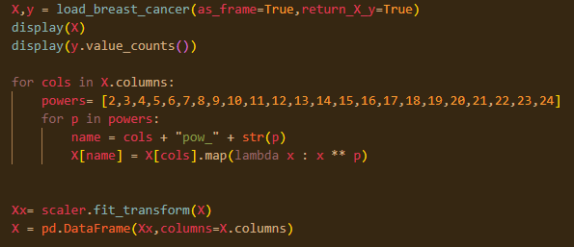
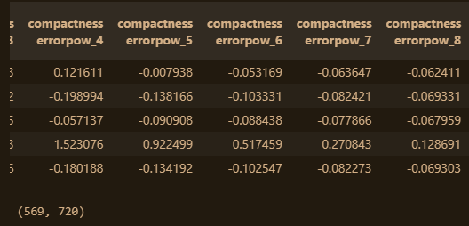
Sklearn Breast Cancer Dataset - Logistic Regression - Multicollinearity
All numerical data
Added power transformations to add the effect of multicollinearity
Multicollinearity occurs when two or more independent variables have a high correlation with one another in a regression model
With transforms there are 720 features and 569 observations
Scaled the X data
Split with a training data as 0.10 and test data as 0.90 to try to overfit the data to the model

Slide 19

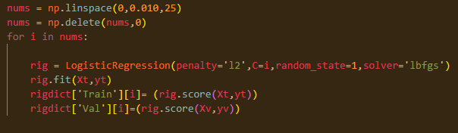
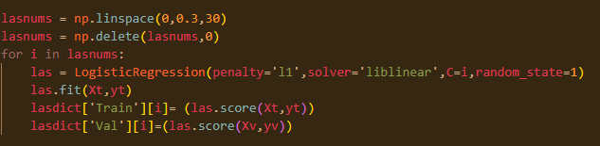
Sklearn Breast Cancer - Logistic Regression Code
Hyperparameters: C with penalty
L2 is ridge penalty
L1 is lasso penalty
In logistic regression, the hyperparameter ‘C’ penalizes more with a smaller value and less with a larger value

Slide 20
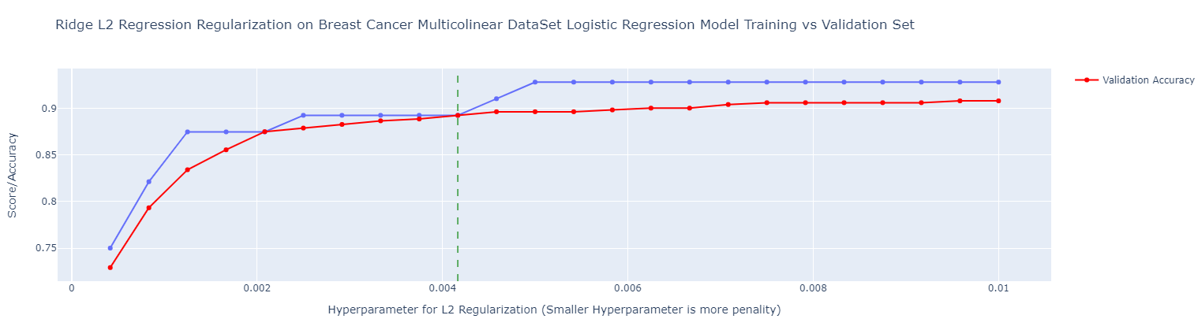
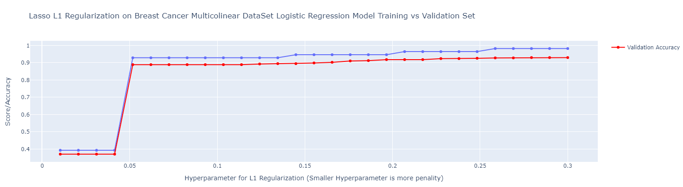

Slide 21

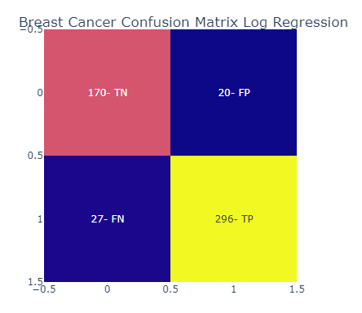
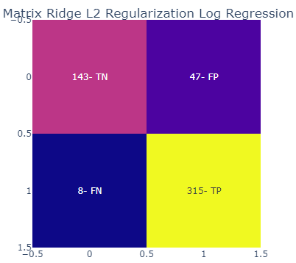
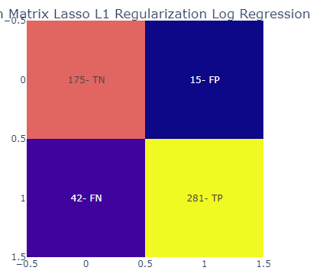
Sklearn Breast Cancer - Confusion Matrices and scores
Lasso and Ridge scores show less overfitting compared to no penalty logistic regression

Slide 22
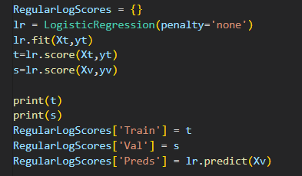
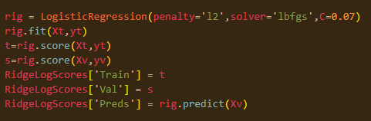
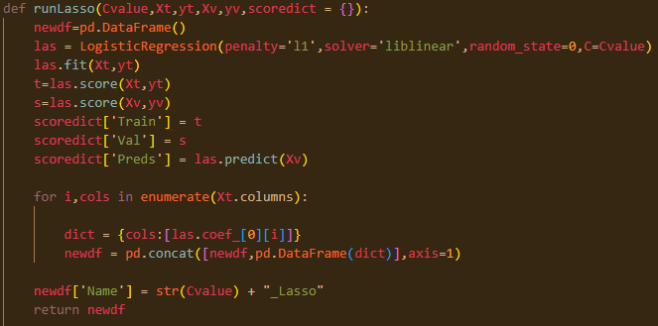
Titanic Dataset - Logistic Regression Code
11 Features
891 Observations
Imputed Numerical Nulls with mean, and Categorical Nulls with most_frequent
Dummy vars for sex:male
Dummy vars for Embarked: Q,S

Slide 23


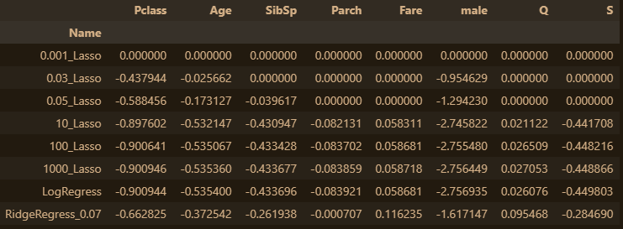



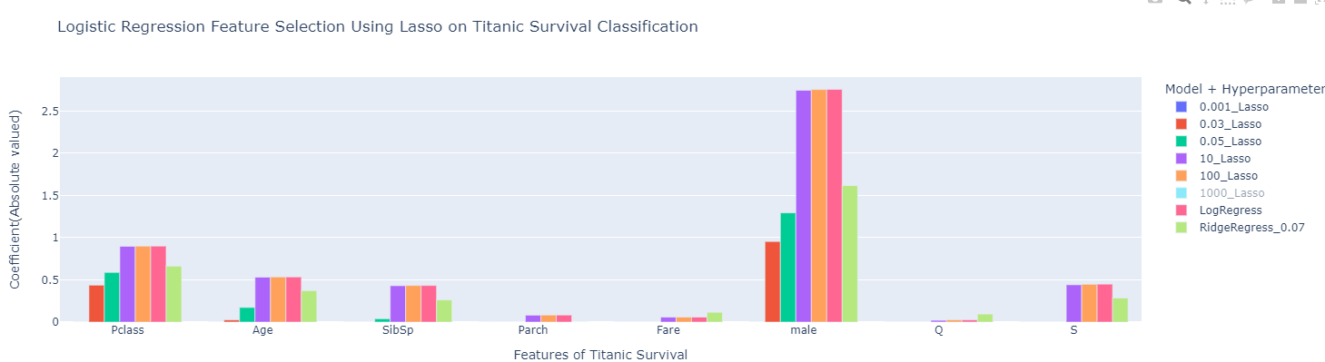
Titanic - Lasso vs Ridge for feature selection

Slide 24
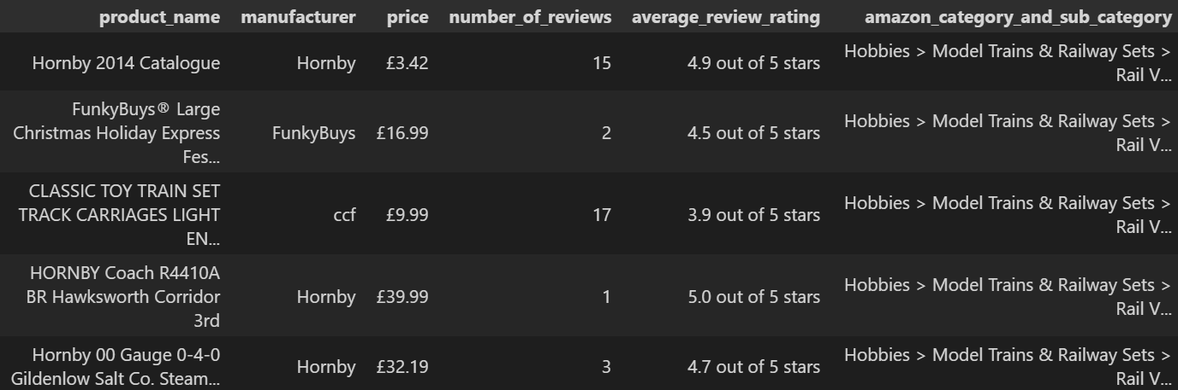
Toy Review Dataset

Slide 25
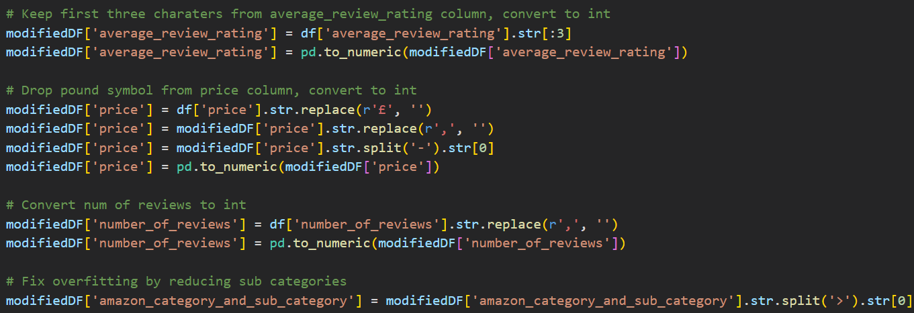
Toy Review Dataset Transformation

Slide 26
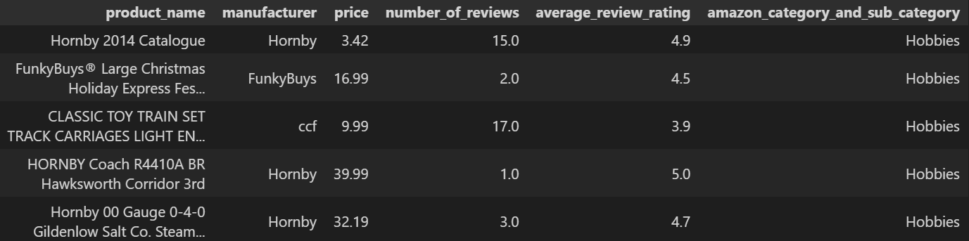
Toy Review Dataset Transformed

Slide 27
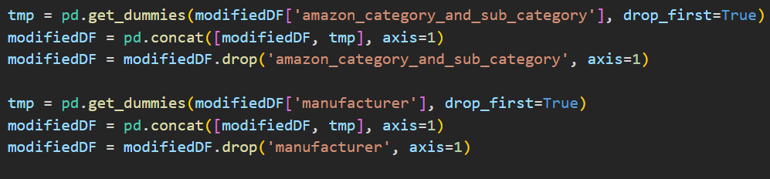
Toy Review Dataset - Dummy Variables

Slide 28
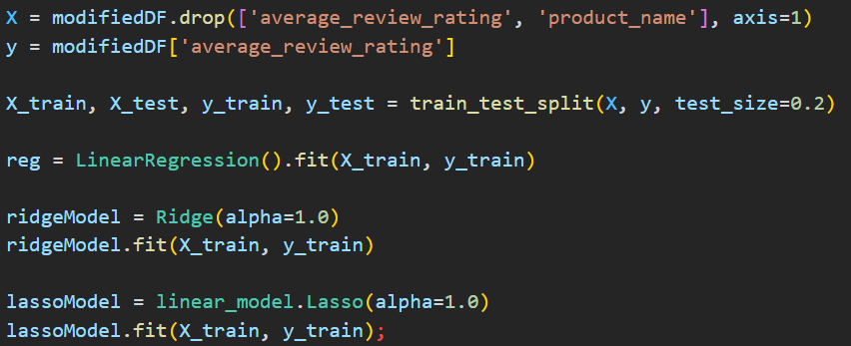
Toy Review Dataset - Fitting the Models

Slide 29
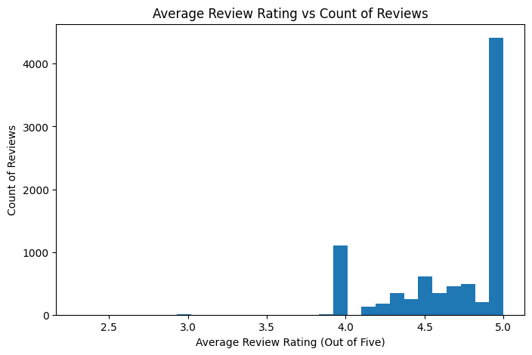

Slide 30
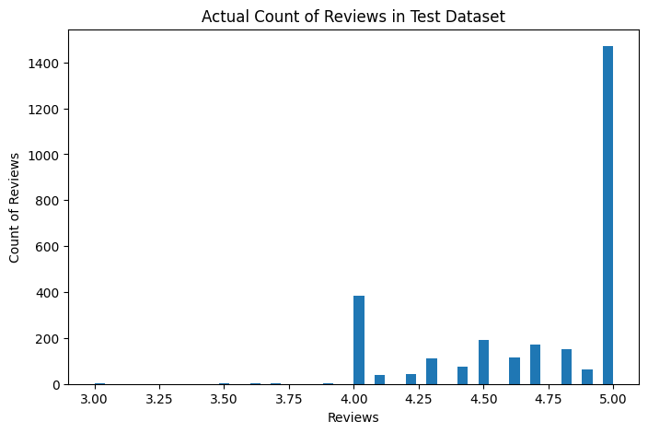

Slide 31
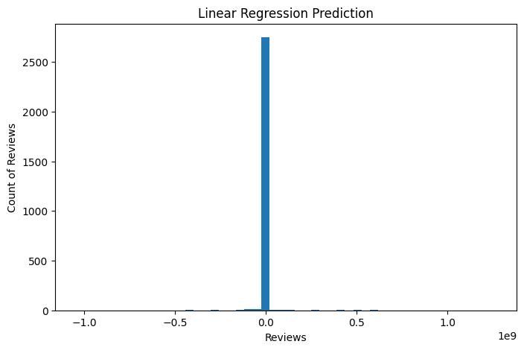

Slide 32
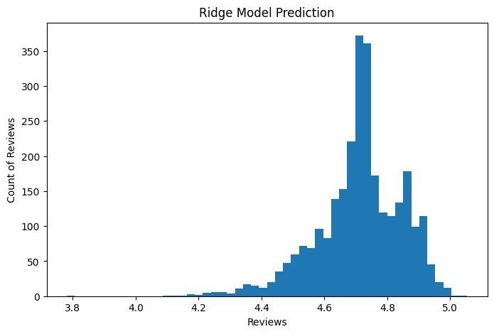

Slide 33
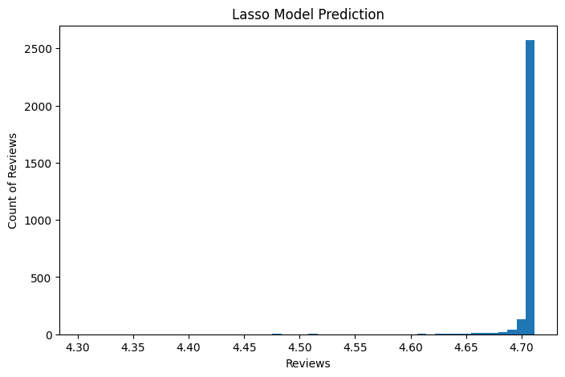

Slide 34
Toy Review Dataset - Correlation
Algorithm | Correlation Value
Linear Regression | -0.0054
Ridge | 0.139
LASSO | 0.111

Slide 35
Links to Resources
When to use LASSO - Crunching the Data
When to use ridge regression - Crunching the Data
Ridge and Lasso Regression Explained (tutorialspoint.com)
Pros and Cons of Common Machine Learning Algorithms
Ridge Documentation 1
Ridge Documentation 2
Lasso Documentation
Ridge vs Lasso Regression, Visualized Video

